Slide 1
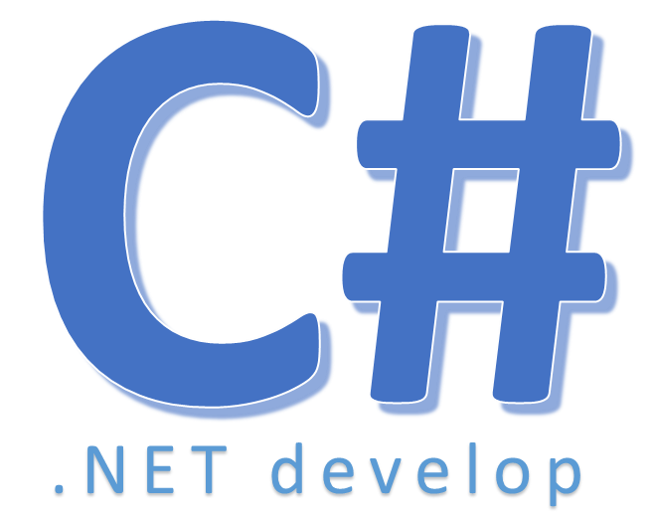

Anonymous Types

Slide 2
Nội dung
Implicitly type functionality for objects
– Set property values to object without writing class definition
– The resulting class has no usable name
– Class name is generated by compiler, inherits from Object
– The result: an anonymous type that is not available at source code level
Also called Projections
Notes:
một lớp không tên

Slide 3
Nội dung
When to user anonymous types
– Need a temporary object to hold related data
– Don’t need method
– If we need a different set of properties for each declaration
– If we need to change the order of properties for each declaration

Slide 4
Nội dung
When not to user anonymous types
– Need to define methods
– Need to define another variable dd
– Need to shared data across methods
private void btn4_Click(object sender, EventArgs e)
{
var teo = new { ID=1234,Name="Tèo Hả Tèo"};
MessageBox.Show(teo.ID +"-"+teo.Name);
}

Slide 5


Hey! Coding is easy!
END

